Slide 1
Introduction to
Computers and Programming

Slide 2
What is a Computer?
Computer – programmable machine designed to follow instructions
Computers can do such a wide variety of things because they can be programmed. This means computers are designed to do any job that their programs tell them to do
The uses of computers are almost limitless in our everyday lives
In school, students use computers for tasks such as writing papers, searching for articles, sending e-mail, and participating in online classes
At work, people use computers to conduct business transactions, communicate with customers and coworkers, analyze data, make presentations, control machines in manufacturing facilities, and many many other tasks
At home, people use computers for tasks such as paying bills, shopping online, social networking, and playing computer games

Slide 3
Why Program?
Program – set of instructions in computer memory to make it do something
Programs are commonly referred to as software. Software is essential to a computer because without software, a computer can do nothing.
Programmer (software developer) – person who writes instructions (programs) to make computer perform a task
a person with the training and skills necessary to design, create, and test computer programs.
So, without programmers, no programs; without programs, a computer cannot do anything

Slide 4
Computer Systems
Computer systems consist of two main components:
Hardware devices and
Software components

Slide 5
Computer Hardware Component Categories
Hardware refers to the physical components of which a computer is made. A computer is not an individual device, but a system of devices.
A typical computer system consists of the following major hardware components:
Central Processing Unit (CPU)
Main Memory
Secondary Memory / Storage
Input Devices
Output Devices

Slide 6
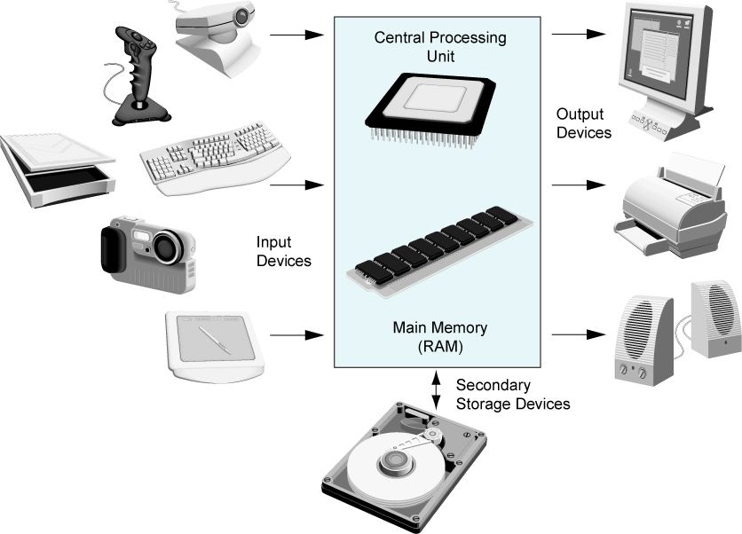
Computer Hardware
Figure-1: Typical devices in a computer system

Slide 7
Central Processing Unit (CPU)
The central processing unit, or CPU, is the part of a computer that actually runs programs. The CPU is the most important component in a computer because without it, the computer could not run software.
The CPU’s job is to fetch instructions, follow the instructions, and produce (compute) some result.
Central processing unit (CPU) comprised of two parts:
Control Unit
Retrieves and decodes program instructions
Coordinates activities of all other parts of computer
Arithmetic & Logic Unit
Hardware optimized for high-speed numeric calculation
Hardware designed for true/false, yes/no decisions

Slide 8
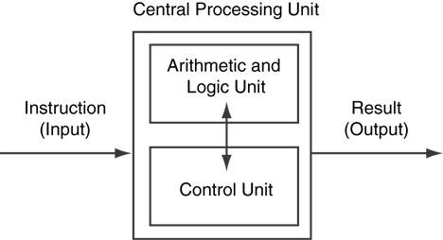
CPU Organization
Figure-2: Organization of a CPU

Slide 9
Main Memory (1 of 2)
Main memory – where the computer stores a program while the program is running, as well as the data with which the program is working.
Main memory also called Random Access Memory (RAM), because the CPU is able to quickly access data stored at any random location in RAM.
RAM is volatile. Main memory is erased when program terminates or computer is turned off
Computer memory is organized as follows:
bit: smallest piece of memory. Has values 0 (off, false) or 1 (on, true)
byte: 8 consecutive bits. Each byte has a unique addresses.

Slide 10
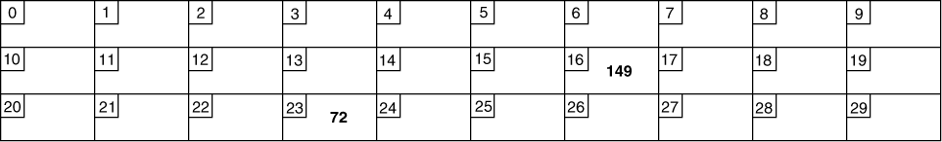
Main Memory (2 of 2)
Addresses – Each byte in memory is identified by a unique number known as an address.
In Figure-3, the number 149 is stored in the byte with the address 16, and the number 72 is stored at address 23.
Figure-3: Memory

Slide 11
Secondary Storage
Secondary storage is a type of memory that can hold data for long periods of time, even when there is no power to the computer
Secondary storage is non-volatile. Data and / or programs retained when computer is turned off
Programs are normally stored in secondary memory and loaded into main memory as needed.
Secondary storage comes in a variety of media:
magnetic: traditional hard drives that use a moveable mechanical arm to read/write
solid-state: data stored in chips, no moving parts
optical: CD-ROM, DVD
Flash drives, connected to the USB port

Slide 12
Input Devices
Input is any data the computer collects from the outside world
Input Devices that send information to the computer from outside
Many devices can provide input:
Keyboard, mouse, touchscreen, scanner, digital camera, microphone
Disk drives, CD drives, DVD drives, and USB drives can also be considered input devices because programs and information are retrieved from them and loaded into the computer’s memory.

Slide 13
Output Devices
Output is any information the computer sends to the outside world. It might be a sales report, a list of names, or a graphic image.
The information is sent to an output device, which formats and presents it.
Common output devices are :
screens, printers, plotters and speakers.
Storage devices (like Disk drives, CD drives, DVD drives, and USB drives) can also be considered output devices because the CPU sends them data to be saved.

Slide 14
Software or Programs
Everything a computer does, from the time you turn the power switch on until you shut the system down, is under the control of software.
There are two general categories of software:
System software: programs that control and manage the basic operation of a computer hardware and the programs that run on them.
Examples: operating systems, utility programs, Compilers and software development tools
Application software: programs to solve specific problems that provide services to the user and make a computer useful for everyday tasks.
Examples : word processing, presentation program, spreadsheet programs, e-mail programs, web browsers, and game programs.

Slide 15
Programs and Programming Languages (1 of 2)
A program is a set of instructions that the computer follows to perform a task
program tells the computer how to solve a problem or perform a task.
Program development process starts with writing an algorithm, which is a set of well-defined steps written in a native (natural) language.

Slide 16
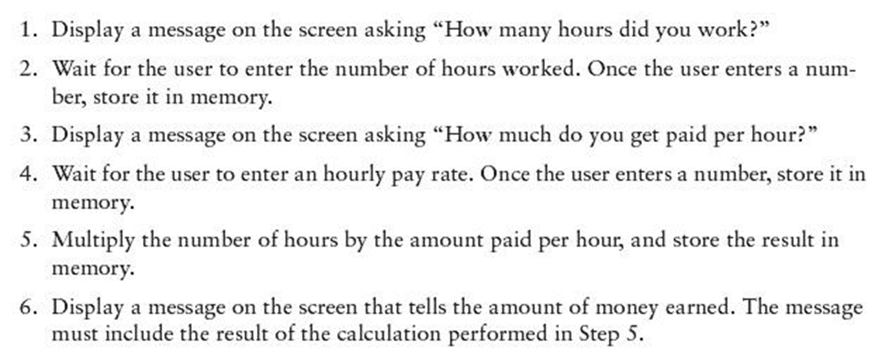
Example Algorithm for Calculating Gross Pay

Slide 17
Machine Language (1 of 2)
Although the previous algorithm defines the steps for calculating the gross pay, it is not ready to be executed on the computer
The computer only executes machine language instructions
Machine language instructions are binary numbers (numbers consisting of only 1s and 0s)
The binary numbers form machine language instructions, which the CPU interprets as commands. Following is an example of what a machine language instruction might look like:
1011010000000101

Slide 18
Machine Language (2 of 2)
The process of encoding an algorithm in machine language is very tedious and difficult
Each different type of CPU has its own machine language
Rather than writing programs in machine language, programmers use programming languages writing programs
Programming languages use words instead of numbers, were invented to ease the task of programming
A program can be written in a programming language, such as C++, which is much easier to understand than machine language
Programmers save their programs in text files, then use special software (compiler) to convert their programs to machine language.

Slide 19
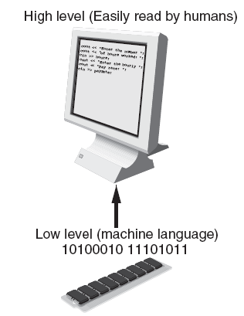
Programs and Programming Languages (2 of 2)
Two types of programming languages:
Low-level language is close to the level of the CPU, which means it resembles the numeric machine language of the computer more than the natural language of humans
used for communication with computer hardware directly. Often written in binary machine code (0’s/1’s) directly.
High-level language is closer to human language
High-level languages are closer to the level of human readability than computer readability.
Figure-4: Low-level versus high-level languages

Slide 20
Some Well-Known Programming Languages
C++
BASIC
Ruby
Java
FORTRAN
Visual Basic
C#
Swift
COBOL
Rust
JavaScript
C
Python
Go
Figure-5: High-level Programming languages

Slide 21
From a High-Level Program to an Executable File (1 of 2)
Following are the steps for the development of high-level language program and translate it to a machine language program
Create file containing the program using a text editor.
The program statements written in high-level language are called source code, and the file they are saved in is called the source file
Run preprocessor to convert source file directives to source code program statements.
Run compiler to convert source program into machine instructions.
Run linker to connect hardware-specific code to machine instructions, producing an executable file.
Steps b–d are often performed by a single command or button click.
Errors detected at any step will prevent execution of following steps.

Slide 22
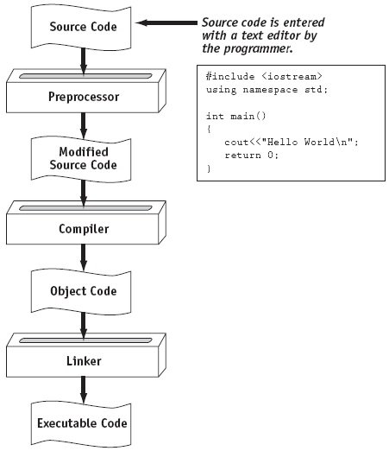
From a High-Level Program to an Executable File (2 of 2)
Figure-6: Translating a C++ source file to an executable file

Slide 23
Integrated Development Environments (IDE) (1 of 2)
An integrated development environment, or IDE, combine all the tools needed to write, compile, and debug a program into a single software application.
These environments (IDE) consist of a text editor, compiler, debugger, and other utilities integrated into a package with a single set of menus.
Examples are Microsoft Visual C++, Turbo C++ Explorer, CodeWarrior, etc.
Figure-7 shows a screen from the Microsoft Visual Studio IDE.

Slide 24
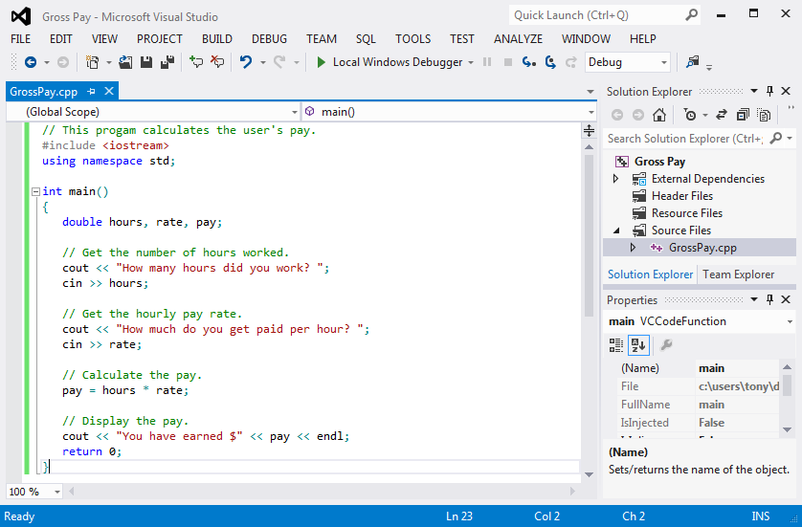
Integrated Development Environments (IDE) (2 of 2)
Figure-7: An integrated development environment (IDE)

Slide 25
What is a Program Made of?
Common elements in programming languages:
Key Words - that have a special meaning. Key words may only be used for their intended purpose. Key words are also known as reserved words.
Programmer-Defined Identifiers - Words or names defined by the programmer. They are symbolic names that refer to variables or programming routines.
Operators - Operators perform operations on one or more operands. An operand is usually a piece of data, like a number.
Punctuation - Punctuation characters that mark the beginning or end of a statement, or separate items in a list.
Syntax - Rules that must be followed when constructing a program. Syntax dictates how key words and operators may be used, and where punctuation symbols must appear.

Slide 26
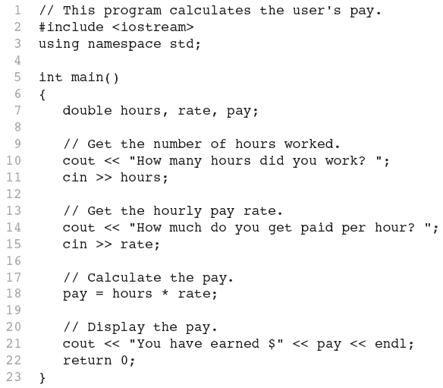
C++ Program
Figure-7: C++ Language Program

Slide 27
Key Words (1 of 2)
Key words are also known as reserved words
Key words have a special meaning in C++
Key words can only be used for their intended purposes, can not be used for any other purpose
In C++ programs, key words are written in all lowercase
Key words in the C++ Program: using, namespace, int, double, and return

Slide 28
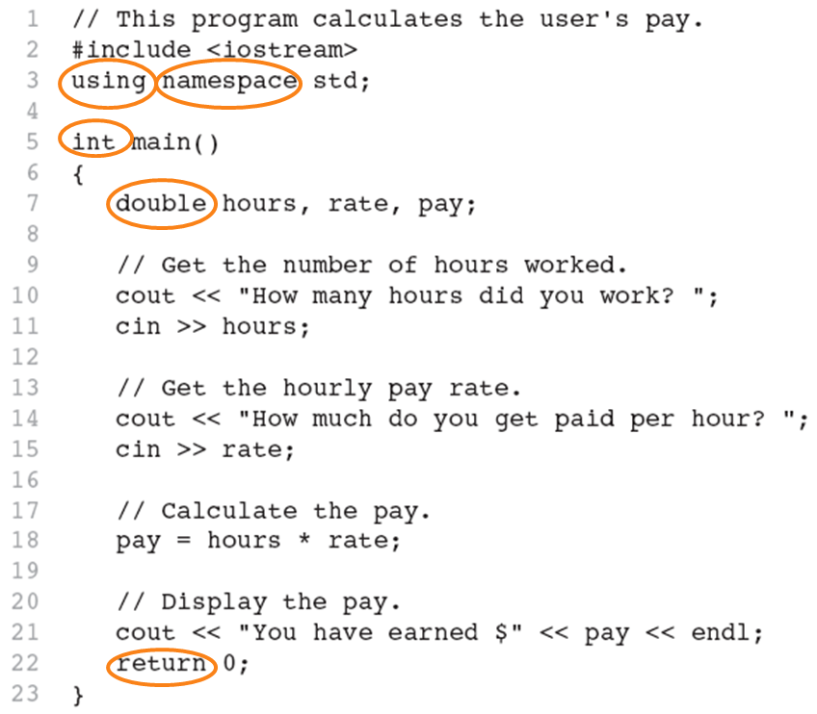
Key Words (2 of 2)

Slide 29
Programmer-Defined Identifiers
Programmer-defined identifiers - Names made up by the programmer
Programmer-defined identifiers are not part of the C++ language
Used to represent various things: variables (memory locations), functions, etc.
In previous C++ Program: hours, rate, and pay are Programmer-defined identifiers.

Slide 30
Operators (1 of 2)
Operators are used to perform operations on piece of data known as operands
Many types of operators:
Arithmetic operators :
Assignment operator: =
Some operators used in previous C++ Program:

Slide 31
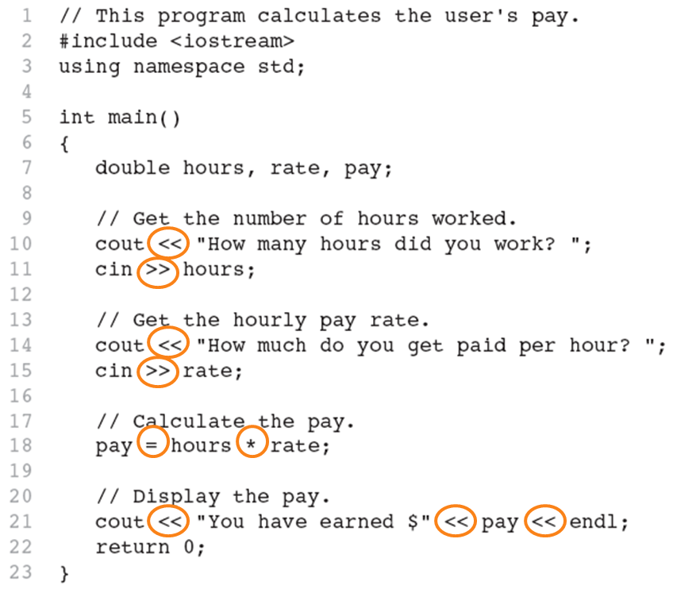
Operators (2 of 2)

Slide 32
Punctuation (1 of 2)
Characters that mark the end of a statement, or that separate items in a list
In previous C++ Program: , and ;

Slide 33
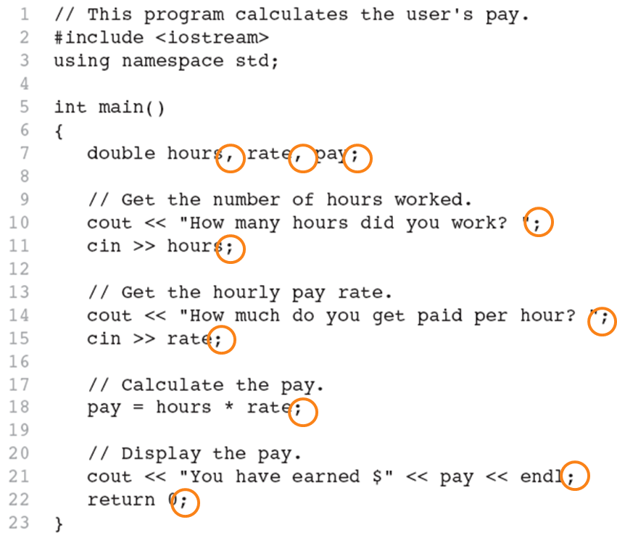
Punctuation (2 of 2)

Slide 34
Syntax
The rules of grammar that must be followed when writing a program
Controls the use of key words, operators, programmer-defined symbols, and punctuation

Slide 35
Variables
A variable is a named storage location in the computer’s memory for holding a piece of data.
In previous C++ Program, we used three variables:
The hours variable was used to hold the hours worked
The rate variable was used to hold the pay rate
The pay variable was used to hold the gross pay

Slide 36
Variable Definitions (1 of 3)
To create a variable in a program you must write a variable definition (also called a variable declaration)
Here is the statement from previous C++ Program that defines the variables:
double hours, rate, pay;

Slide 37
Variable Definitions (2 of 3)
There are many different types of data, which you will learn about in this course.
A variable holds a specific type of data.
The variable definition specifies the type of data a variable can hold, and the variable name.

Slide 38
Variable Definitions (3 of 3)
Once again, line 7 from previous C++ Program:
double hours, rate, pay;
The word double specifies that the variables can hold double-precision floating point numbers.

Slide 39
Input, Processing, and Output
Three steps that a program typically performs:
Gather input data:
from keyboard
from files on disk drives
Process the input data
Display the results as output:
send it to the screen
write to a file

Slide 40
The Programming Process
The programming process consists of several steps, which include design, creation, testing, and debugging activities.
Figure-8 showing the steps recommended for the process of writing a program.

Slide 41
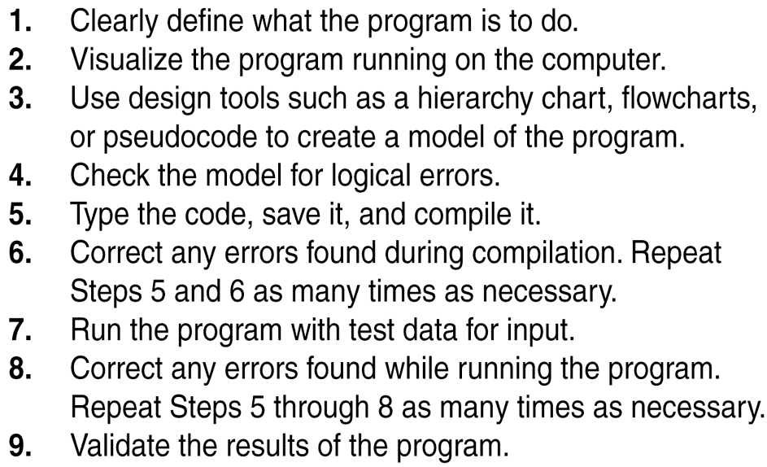
The Programming Process
Figure-8: Steps for writing a program

Slide 42
Procedural and Object-Oriented Programming
Procedural programming and object-oriented programming are two ways of thinking about software development and program design.
Procedural programming: focus is on the process.
The programmer constructs procedures (or functions, as they are called in C++)
The procedures each contain their own variables and commonly share variables with other procedures.
Object-Oriented programming: focus is on objects
An object is a programming element that contains data and the procedures that operate on the data.
Messages sent to objects to perform operations.

